Slide 1
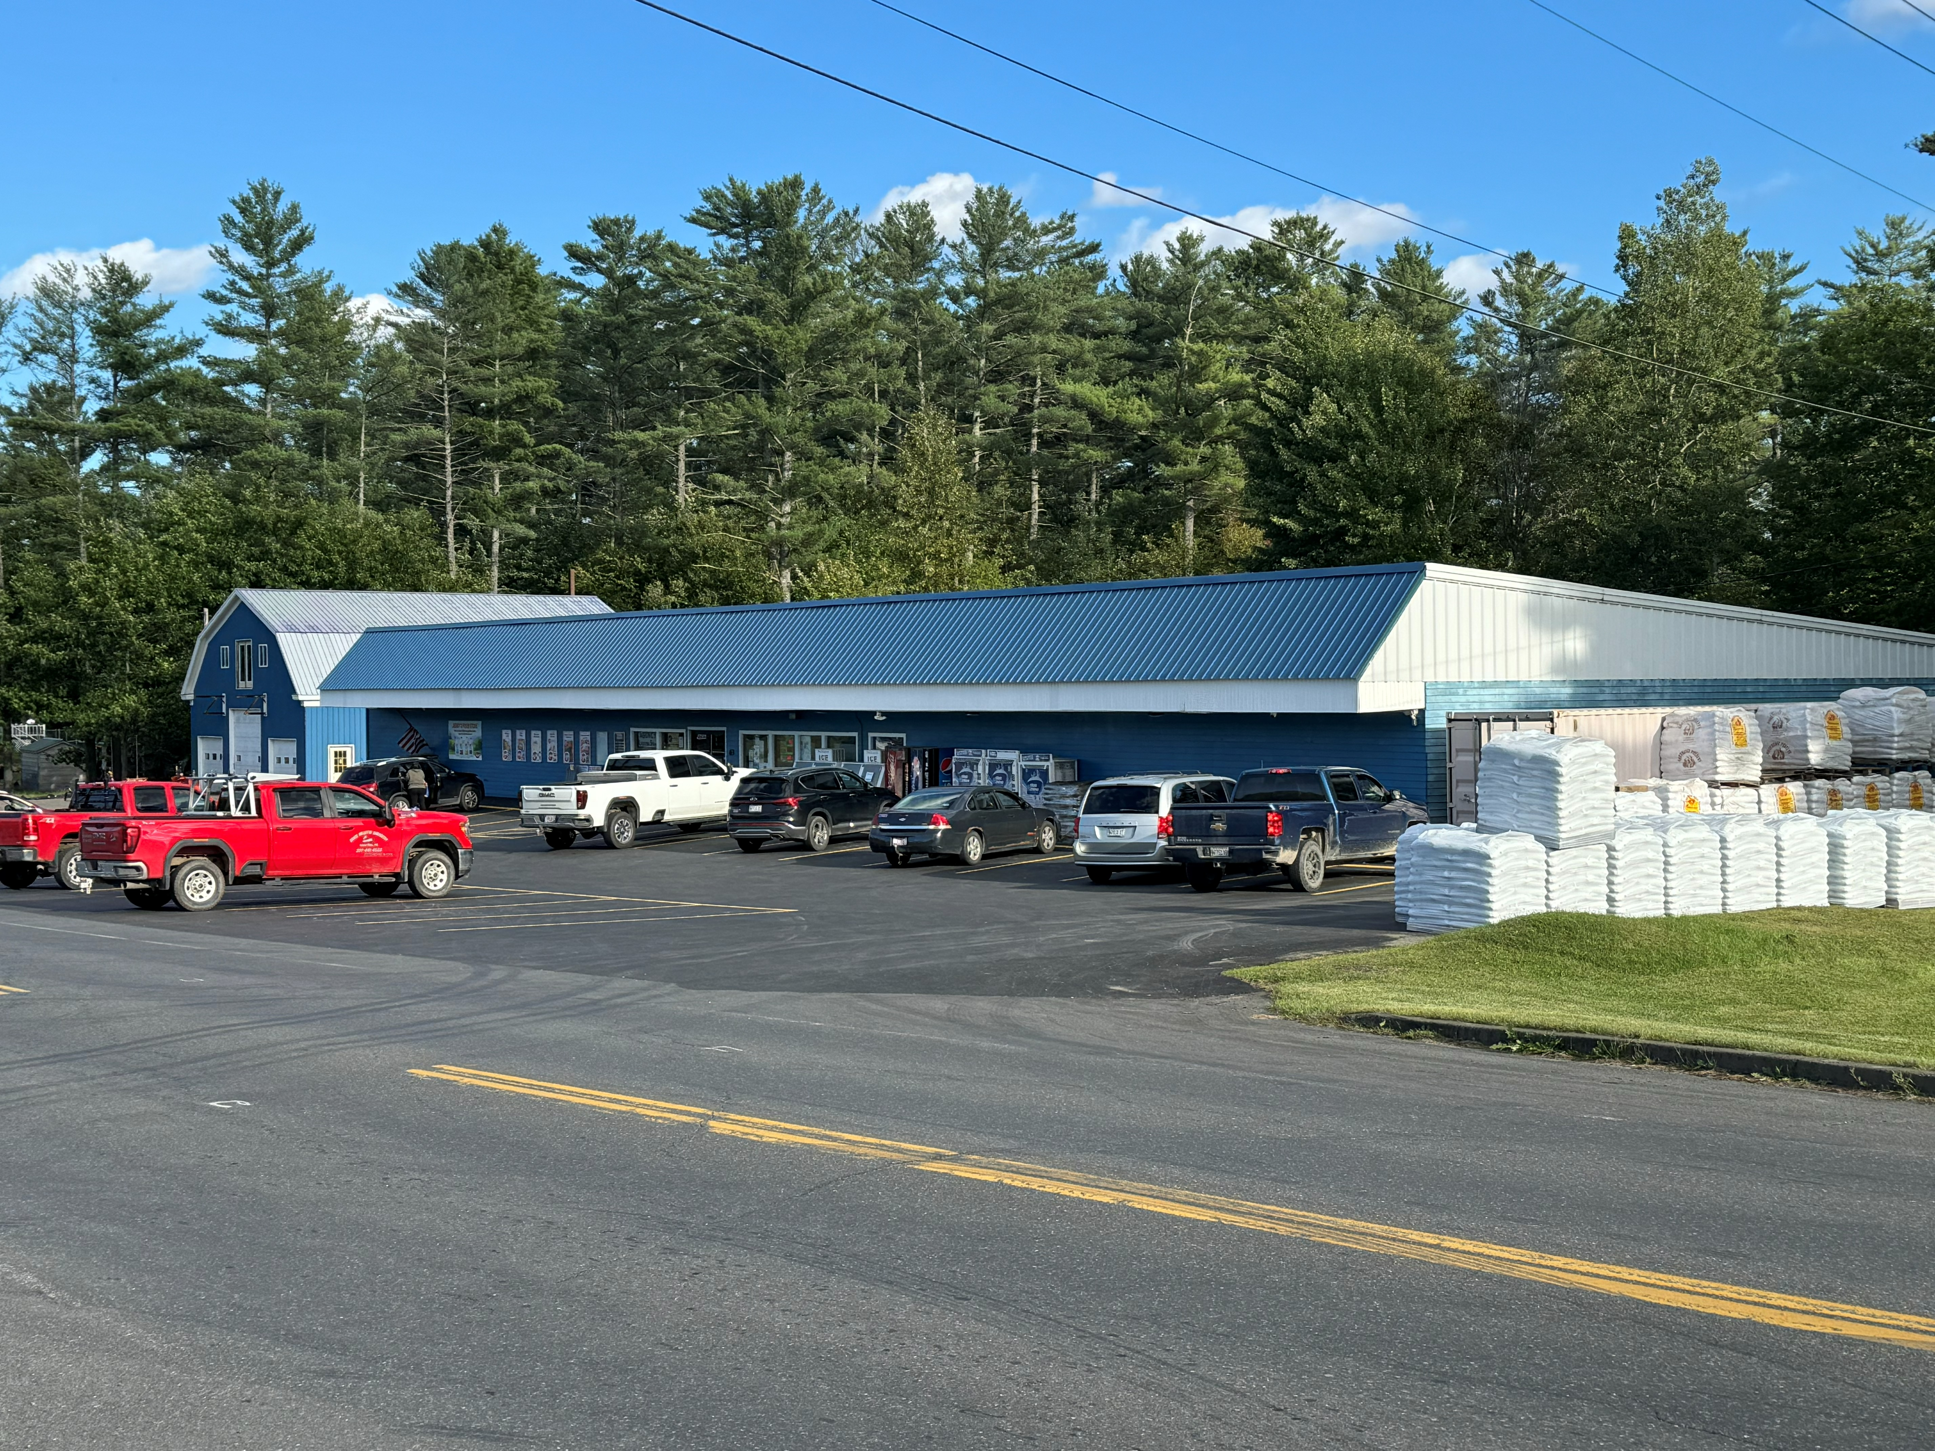
Opportunity exists here in Island Falls
Let’s work together to support a path for Economic Growth!

Slide 2
What is Economic Development?
Definitions
  Economy: The sum of all transactions
  Economic Growth: Activities that increase the production of goods and service.

Slide 3
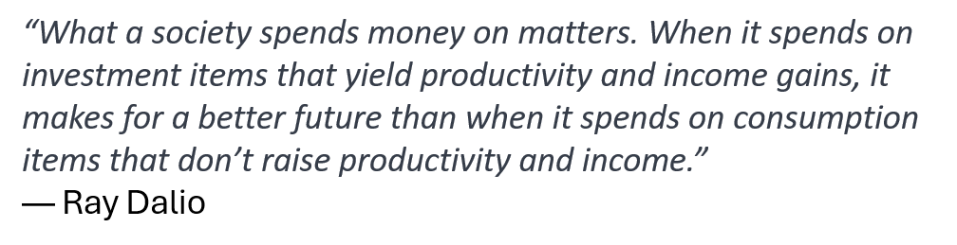



Slide 4

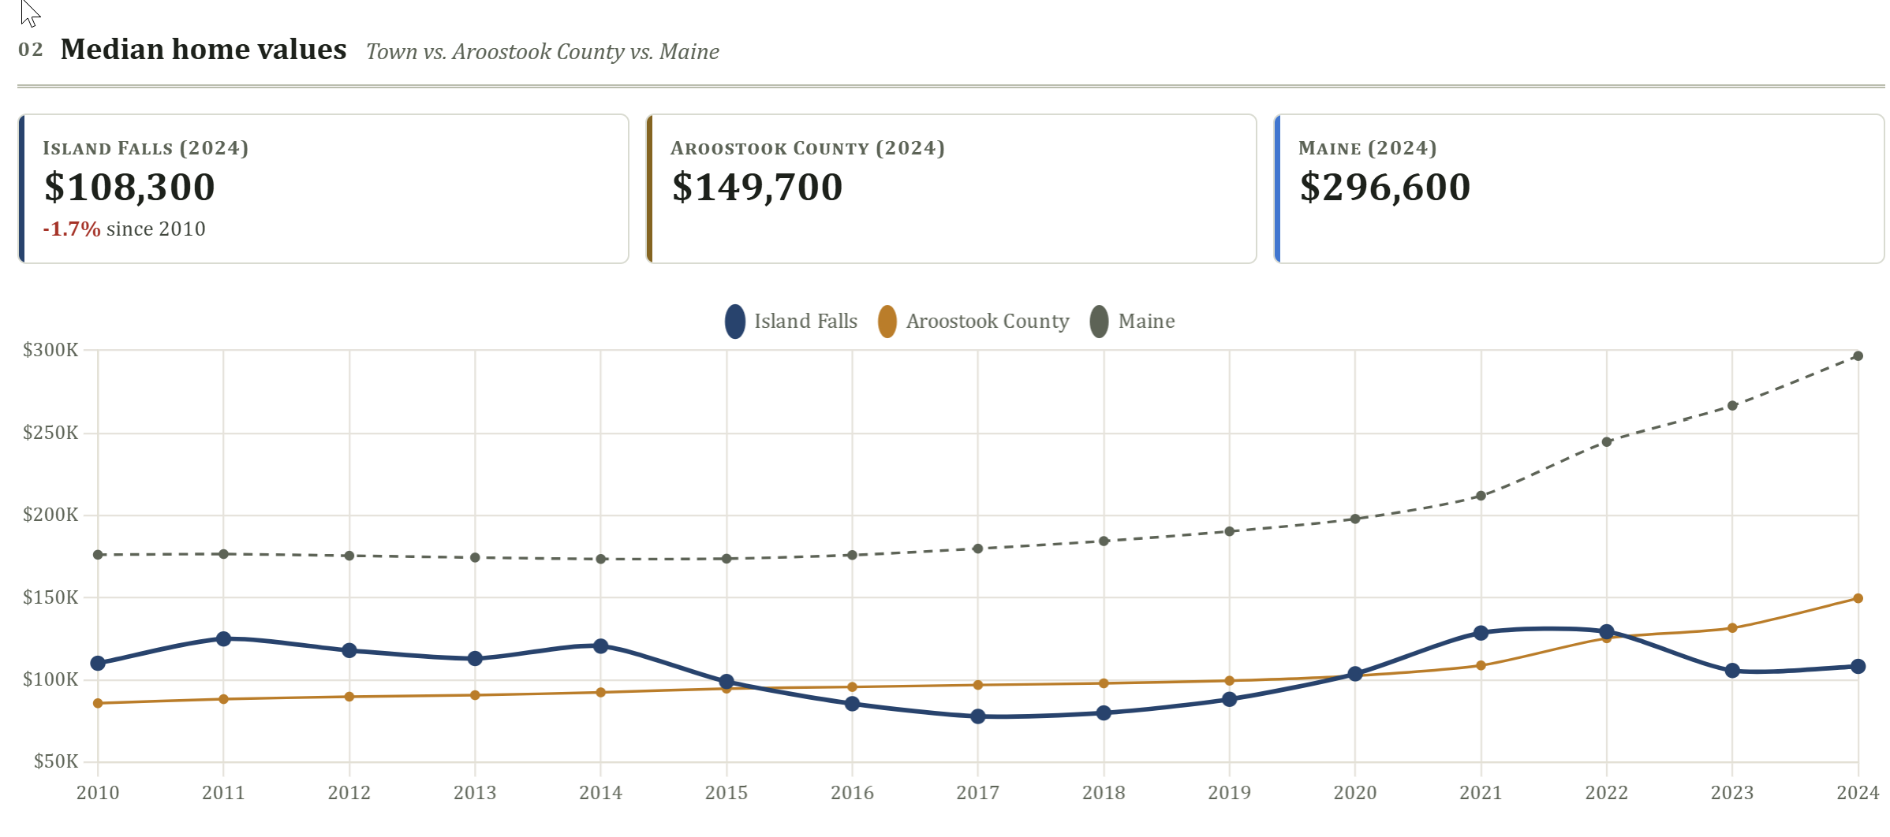
Healthy Economy
The health of an economy can be identified through an exploration of changes in property values, or the number of growing businesses within a town, state, or country.

Slide 5

Let’s explore our biggest challenge to economic growth -
  Our downtown parcels are not performing at their best/highest capacity.

Slide 6

Why Care?
WE ALL BENEFIT!!
The largest contributor to household wealth stems from Home Equity. Higher Prices attract buyers. Lower Prices attract sellers.
  This largest contributor to municipal budgets are Parcels of Land with the most desirable attributes i.e. waterfront, downtown center, accessibility
  Island Falls has many attributes that make it a desirable place to live, work and play. By investing in our downtown, we adapt poor performing lots and turn them into high contribution Parcels of Land.
  Bring low performing lots to their full potential will increase the long-term demand for all Parcels of Land.
More resources for all.
Improved quality of life for our community members.

Slide 7

What happens in an Economic Decline?
WHY?
High Building Vacancy
Limited Job Opportunities
Declining Contribution Sources
Limited Investment Activity
There is an economic weight imposed on the community as the remaining property owners shoulder the weight of the budget, all while facing declining demand for their properties.
Notes:
With High Vacancy comes an inefficient allocation of the burden for costs associated with Town operational expenses.

Slide 8
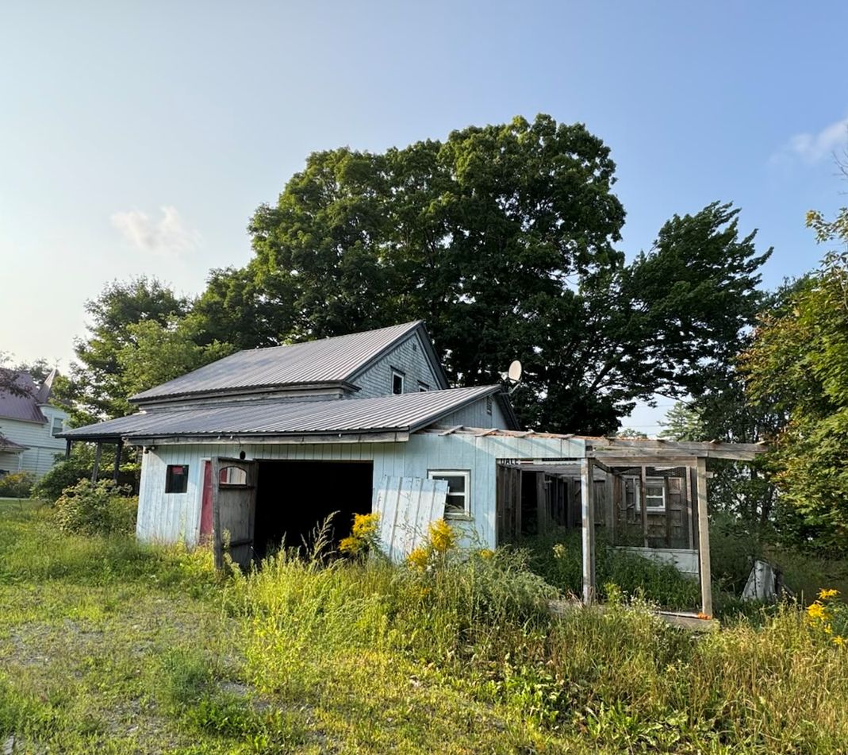
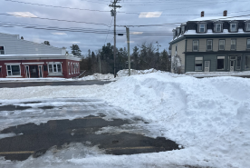
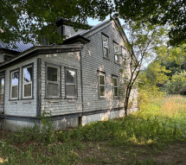
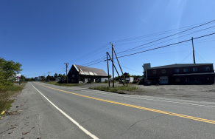
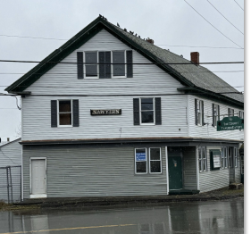
Confirmation?
Many Underperforming Properties
High Mill Rate/Taxes
Suppression of resources.
Fleeting talent.
Aging population
Low demand
Poor housing stock
High Business Turnover
Economic decline
Notes:
The economic conditions have suppressed asset values. This has had a negative impact on the largest contributor to a Mainer’s wealth - their home equity. Property in the downtown remains depressed, and in a condition that discourages investment. This includes reinvestment of home equity in home maintenance projects.

Slide 9
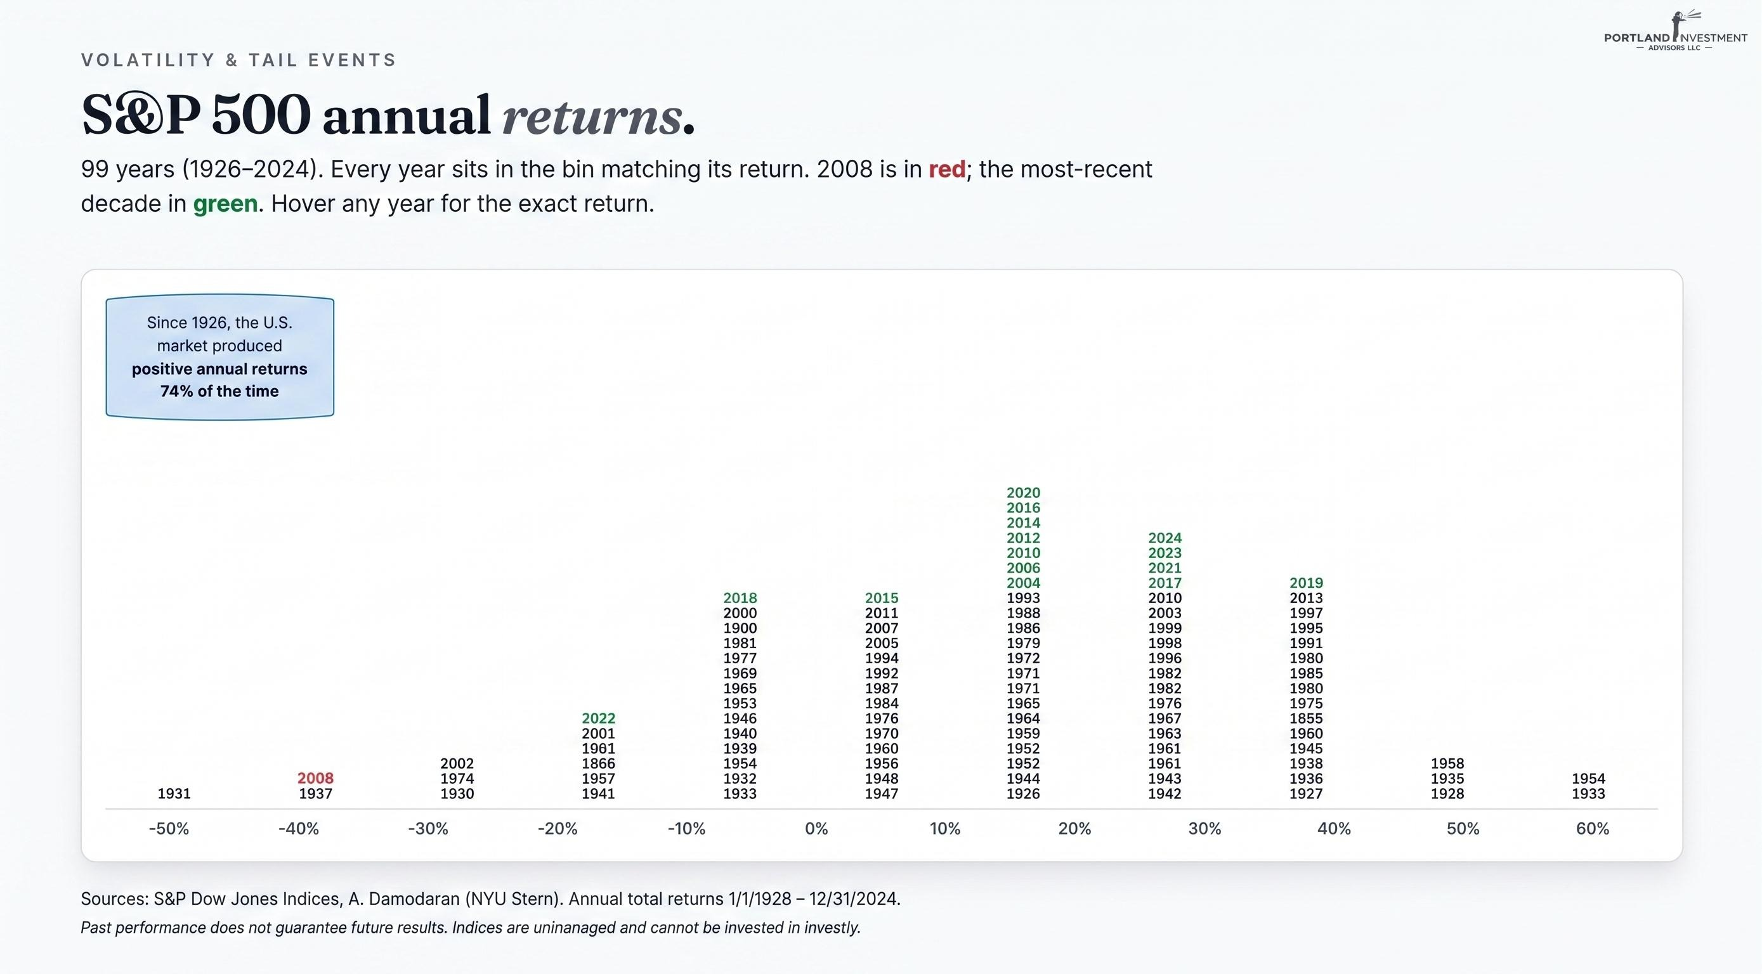
Economic decline is a normal.

Slide 10

Will the problem resolve on its own?
To understand the challenges, we have to understand the relationship between human behaviors, investments and credit.

Slide 11



  Primary drivers for shaping economic decisions
    Economic Profit or Return on Investment-
    Life Experience as Return (LEAR) –
    Philanthropic Motivation –

Slide 12
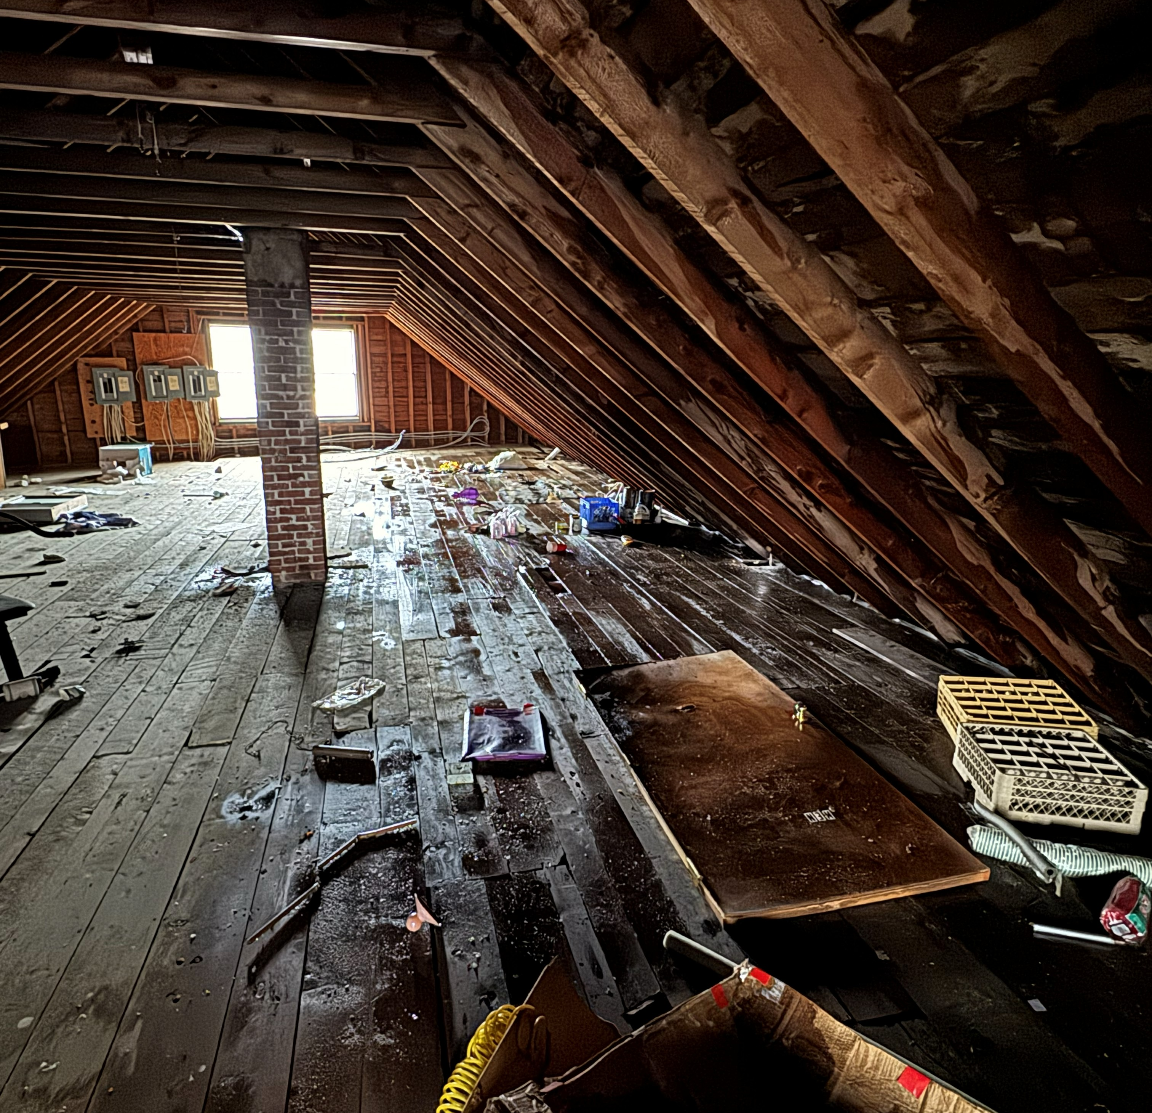
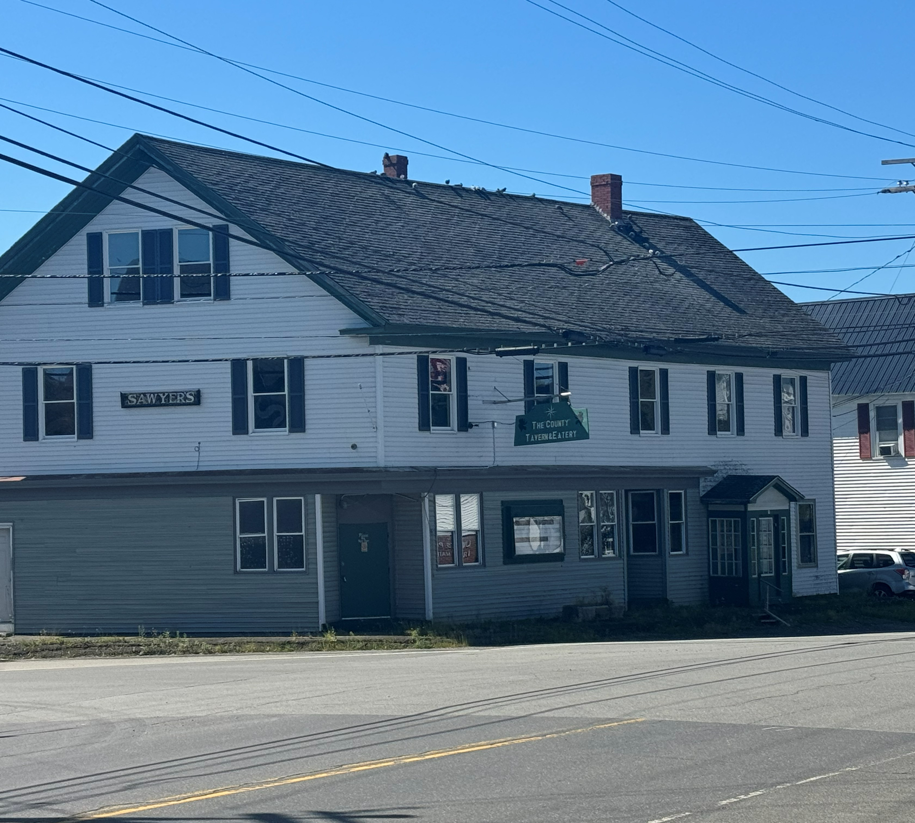
Many buildings in our downtown are in such disrepair that the cost to develop is greater than the project’s ending value.
There are two sides to this equation
  Cost to Produce
  Ending Value (the collateral)

Slide 13
Cost to Produce
  The cost to produce is made up of wages and supplies. Business owners and investors have very limited influence. While at times, wages may appear more competitive to alternative locations within the State, this cost is increased in Island Falls as time and resources are spent on supply delivery.
Ending Value (Collateral)
  Ending Value carries with it the most likely possibility for us to impact change.

Slide 14
Project Ending Values – A Challenge to Overcome
  Appraisals and tax assessment are used for the purpose of determining property values.
    Suppressed comparables suppress credit and investment, and lead to lower Parcel Contributions.
  In our Downtown, we face the challenge of declining property values.
    Economic Weight on the remaining properties (increased tax burden)
    Affordability decreases - continuing the downward pressure on the health of the economy.

Slide 15
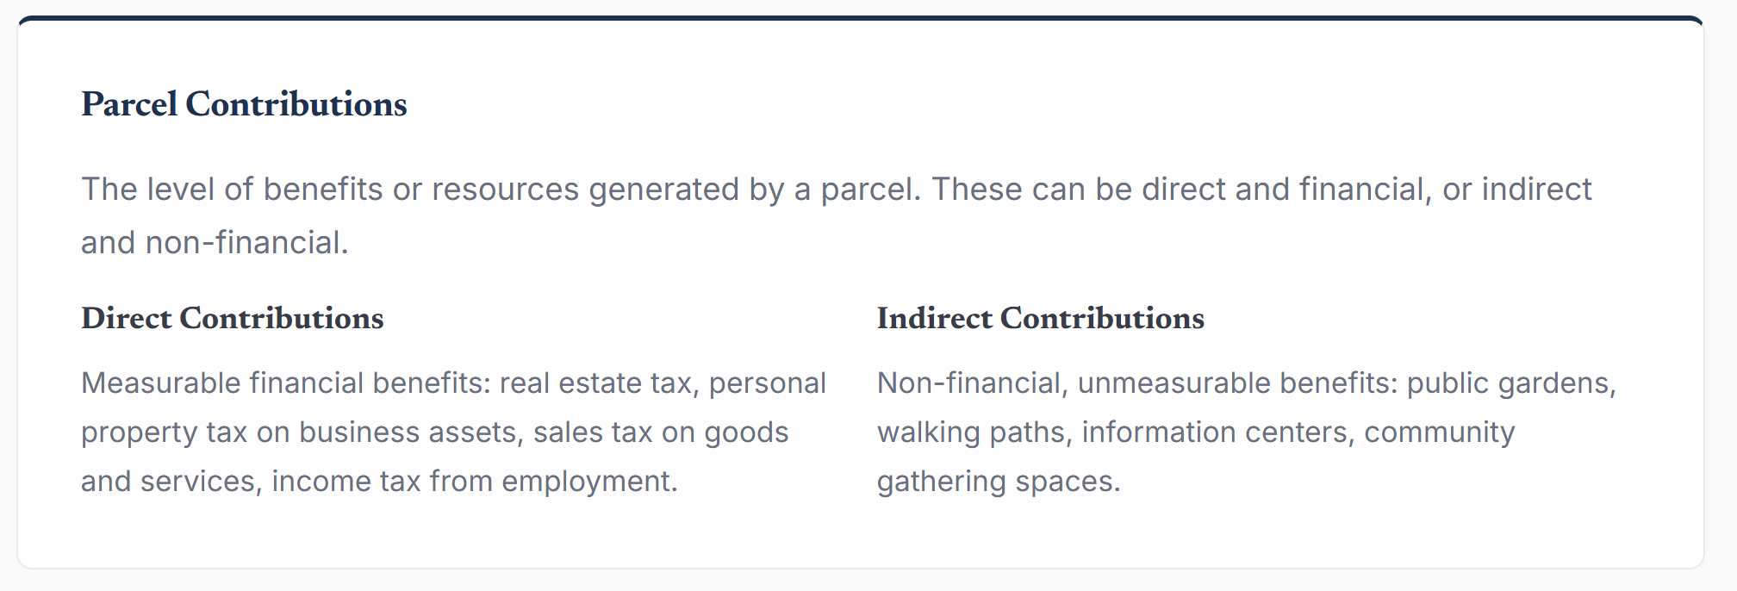
Town Parcels = Resources For Our Community

Slide 16
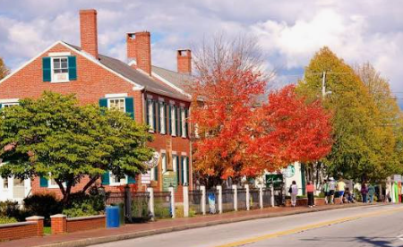
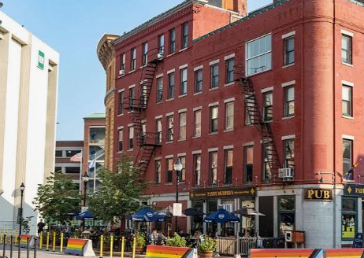
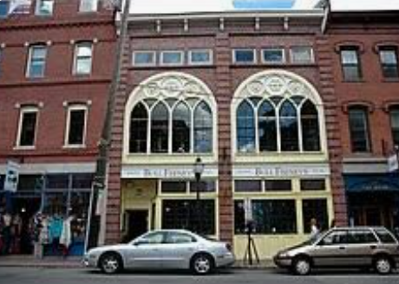
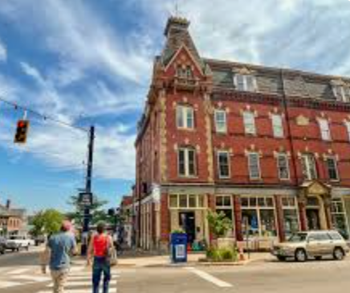
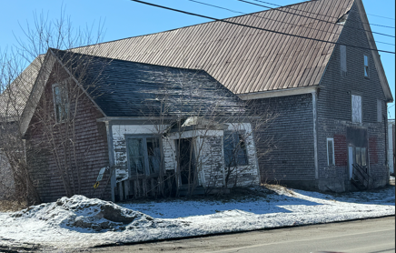
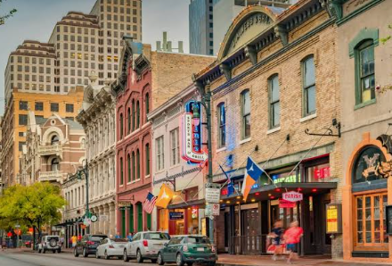
Town Identity?

Slide 17
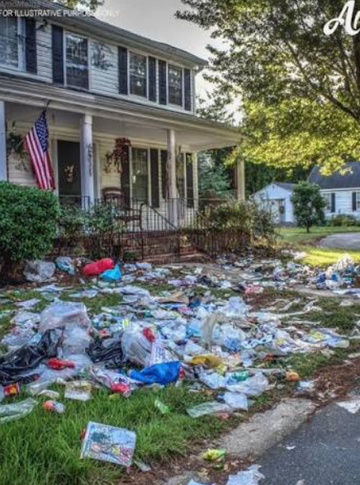
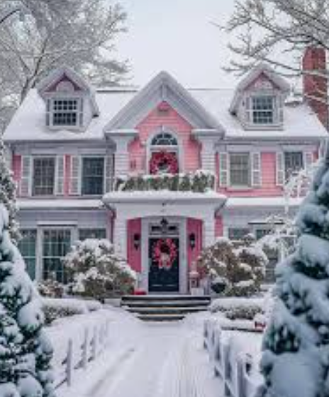
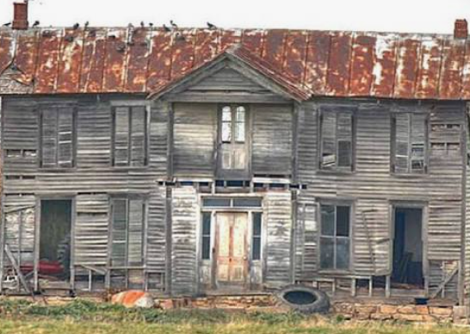
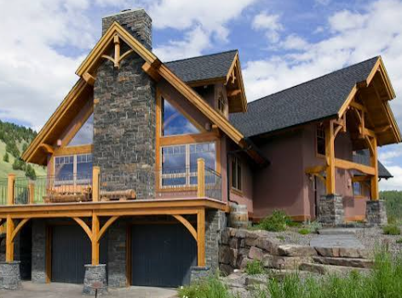
The Power of Unfair Advantage
Certain Properties demand more influence on the neighborhood than others!
    Anchor Properties
    Critical Lots

Slide 18
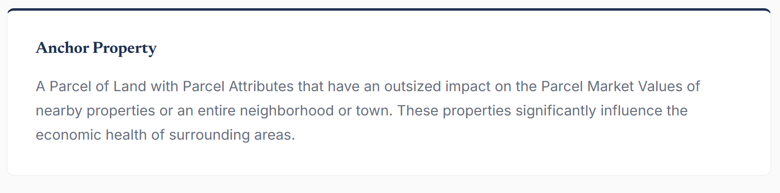
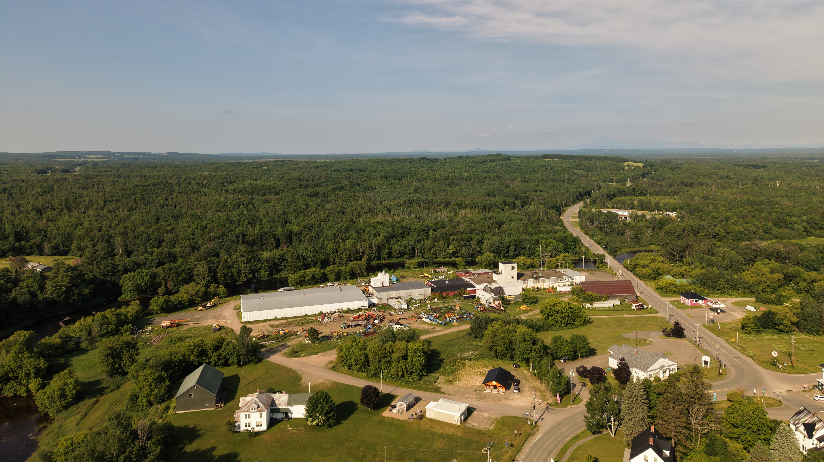
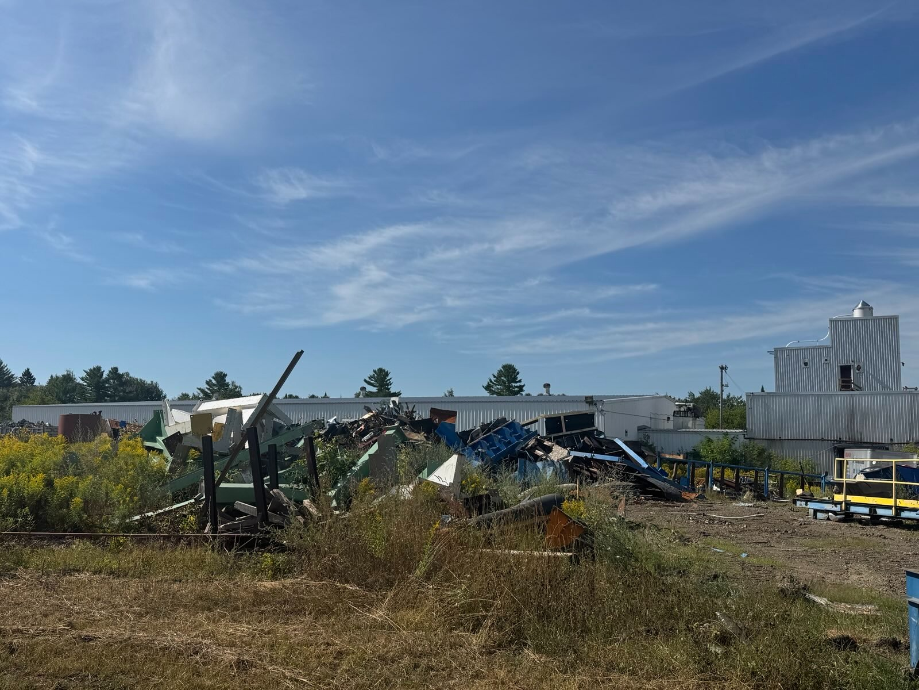

Slide 19
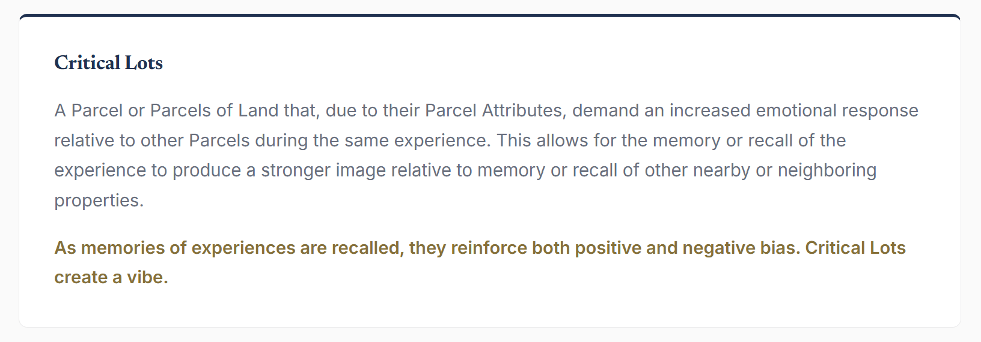
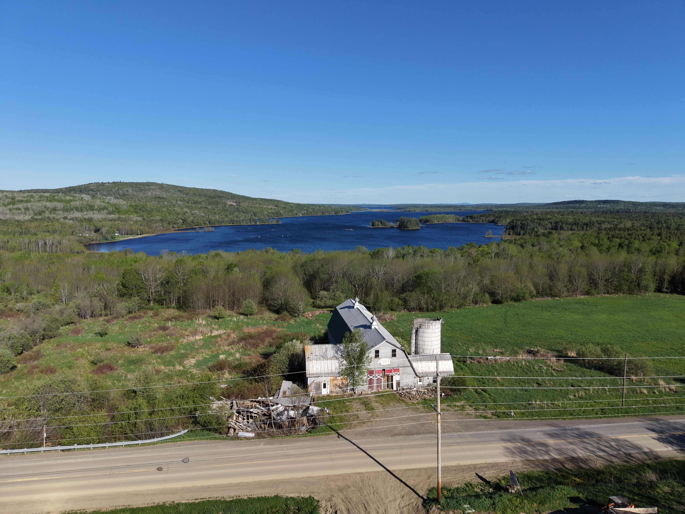
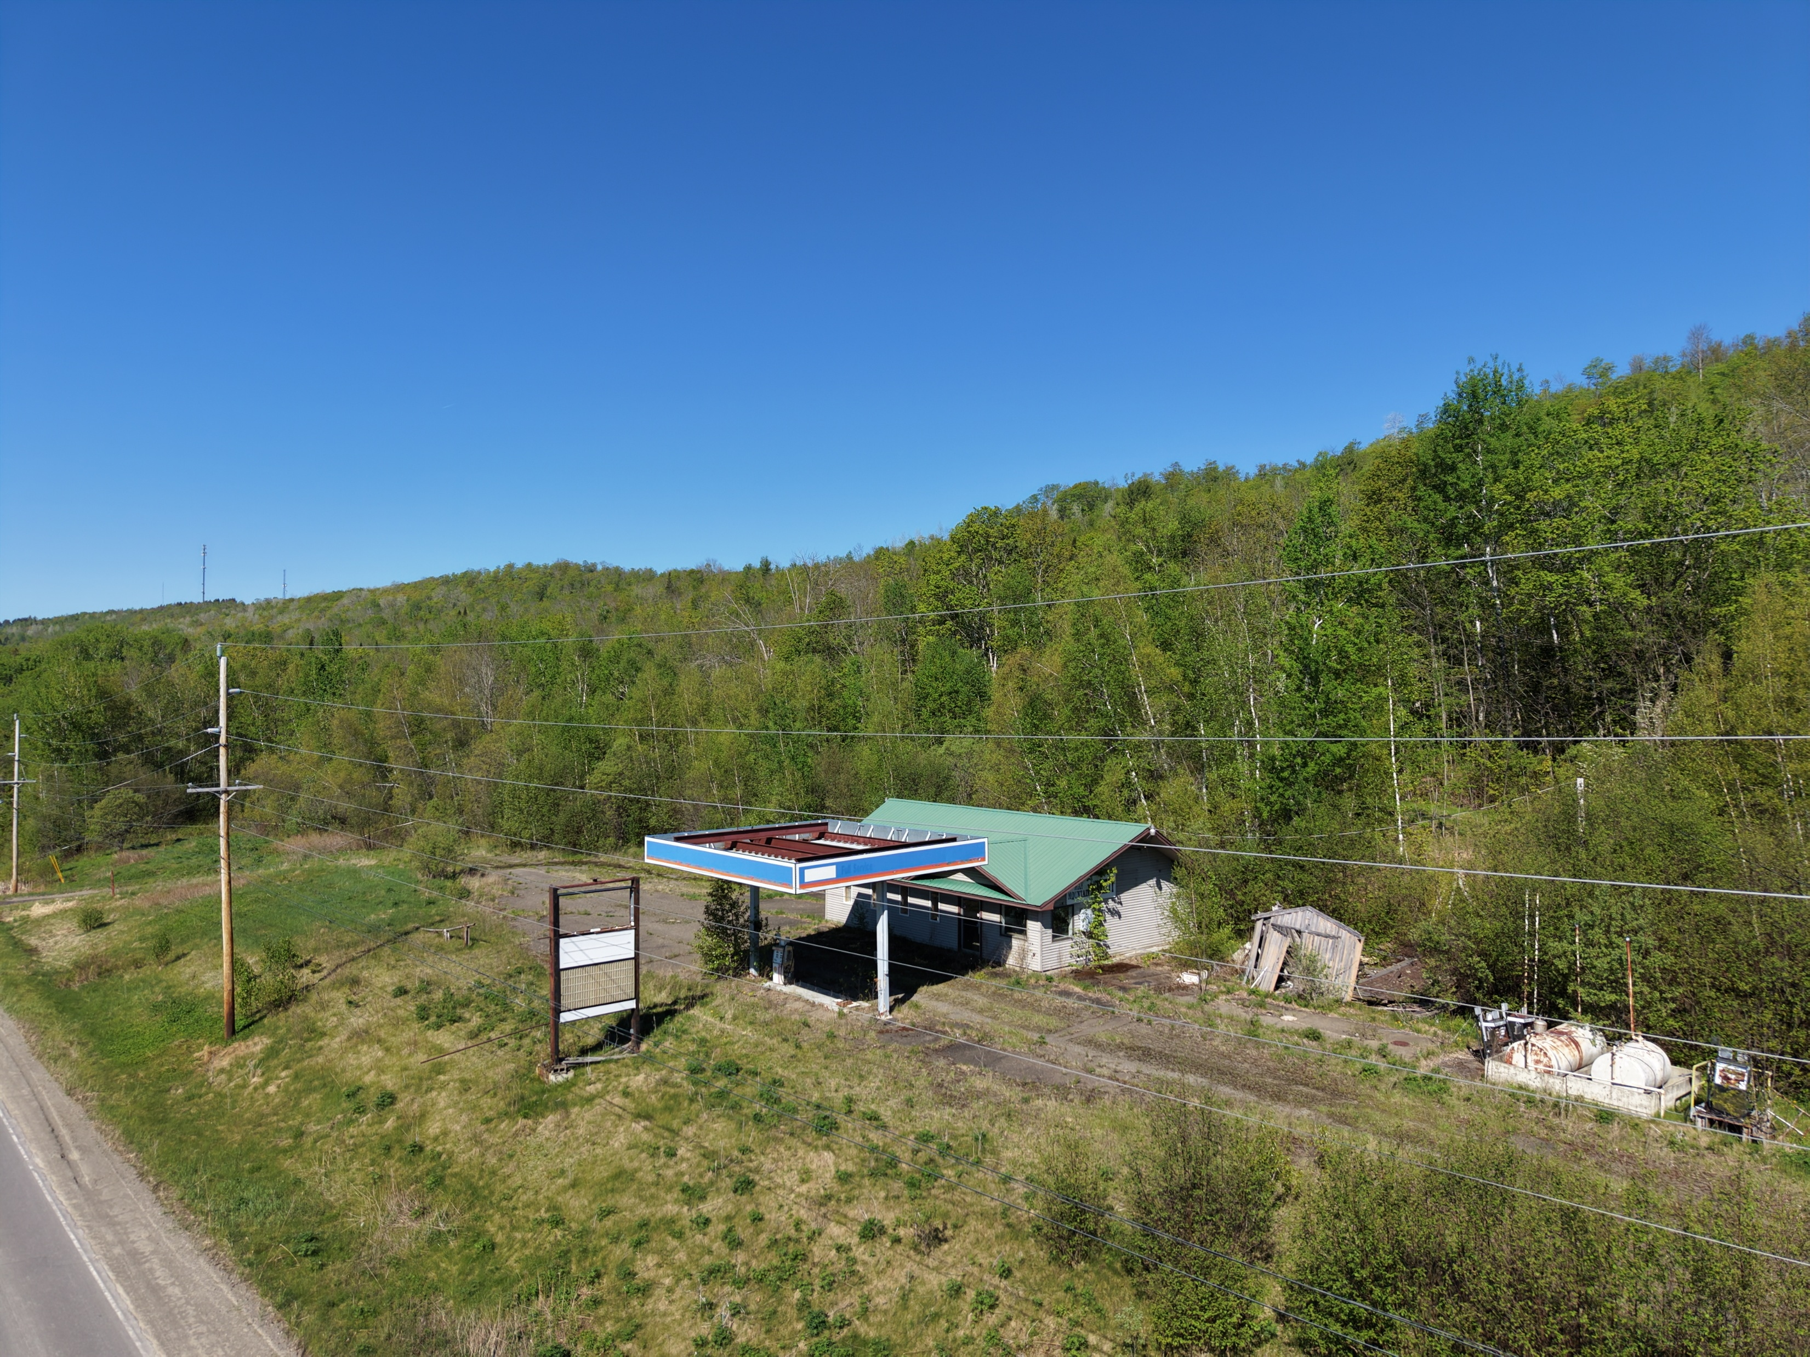
*There are many critical lots that present an image to the minds of the passersby. Are we projecting opportunity?

Slide 20
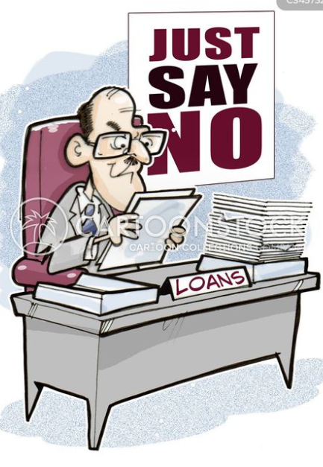
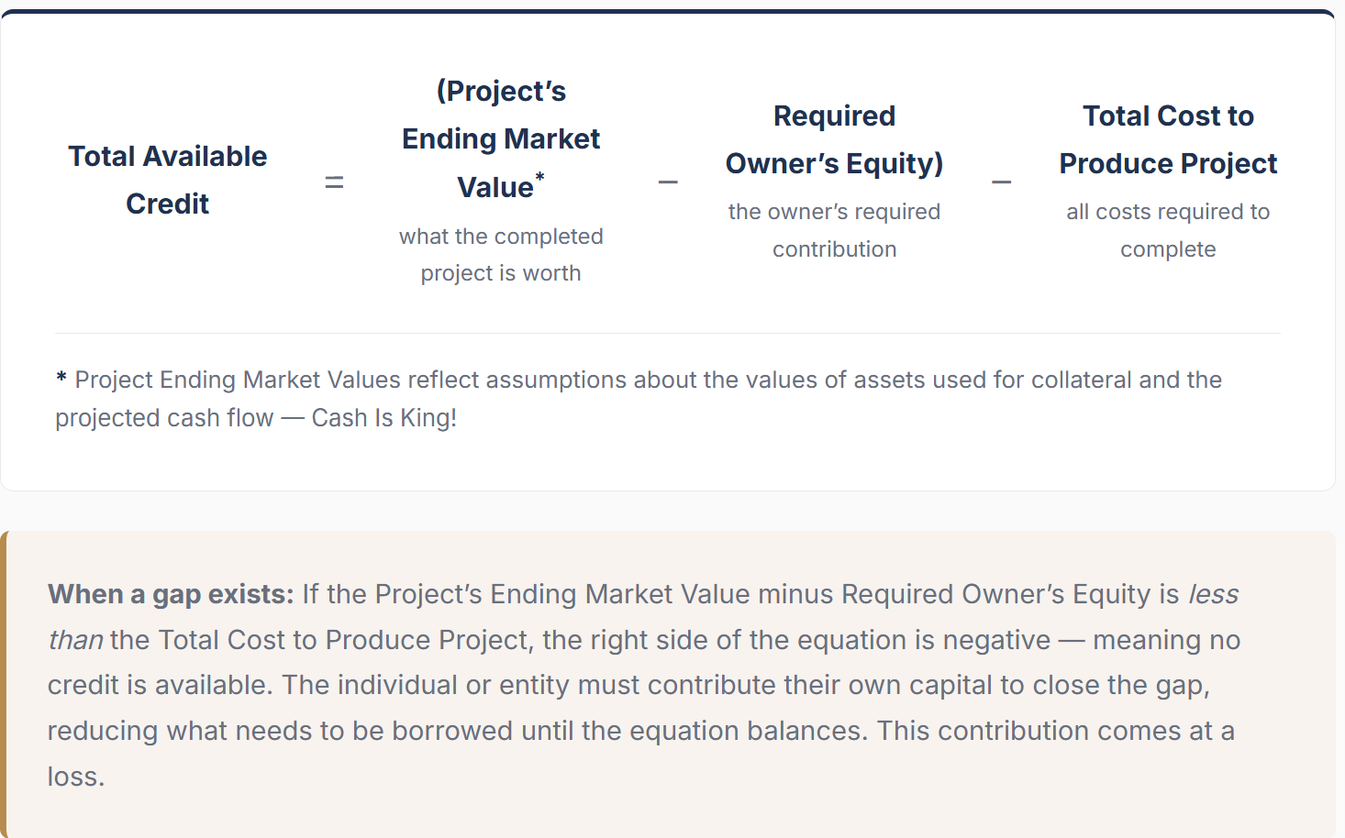


“Credit is the most important part of the economy, and probably the least understood” – Ray Dalio
* This is a simplification of the credit approval process but holds true to the relationship between credit and the require collateral.

Slide 21
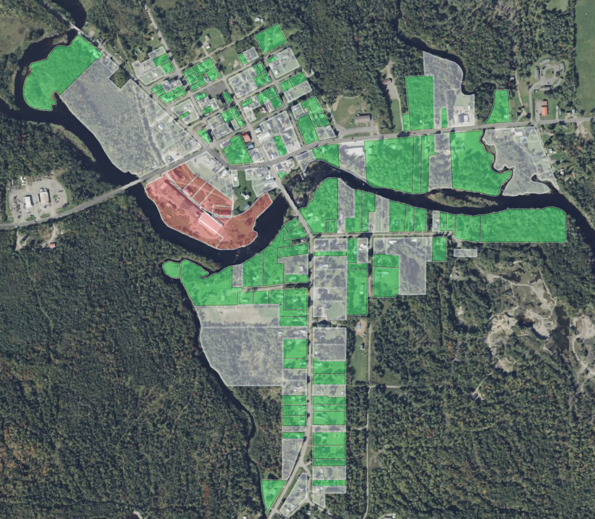
STARCH FACTORY LOTS
Average Downtown Lots
$2,201
Tax Revenue / Acre
Average Downtown Residents
$1,707
Tax Revenue / Acre
Downtown core is anchored by the old starch factory
  Located on prime property, waterfront, and immediate downtown access
  Situated ideally, these lots should reflect higher values accordingly
Does not generate tax revenue representative of downtown lots
  Downtown Residents generate the most property tax revenue per acre ~ around $1707 per acre
  The starch factory generates 44% less than similar lots
Starch Factory Lots
$947
Tax Revenue / Acre

Slide 22
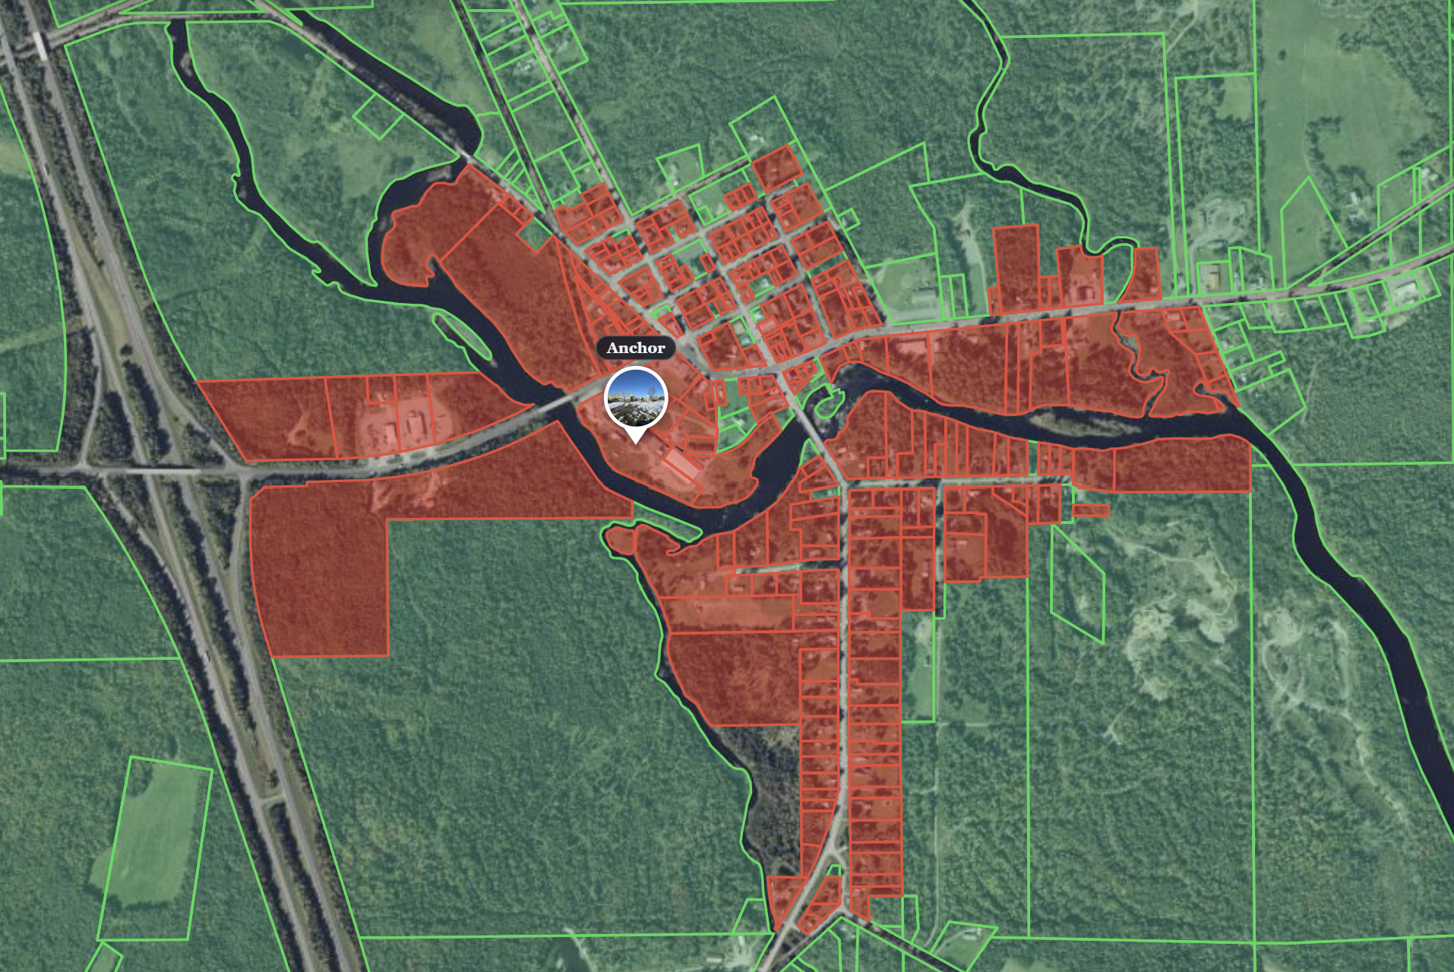
Down Town Zone

Slide 23
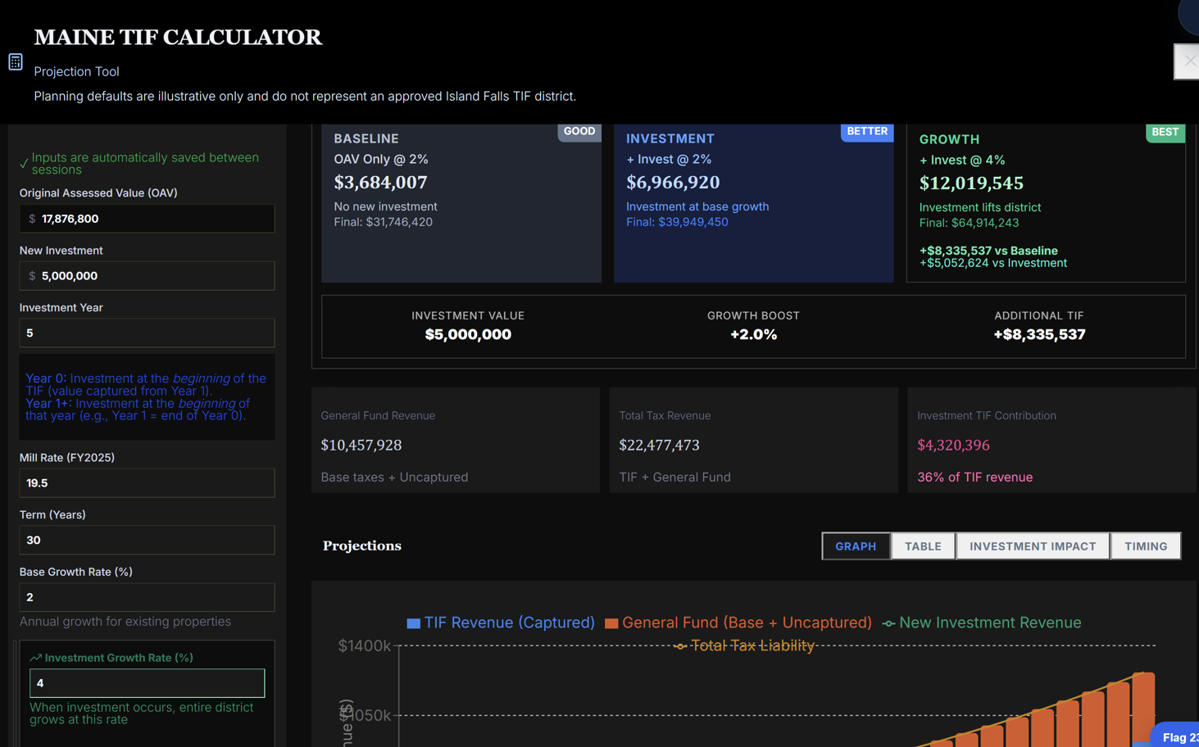

Slide 24
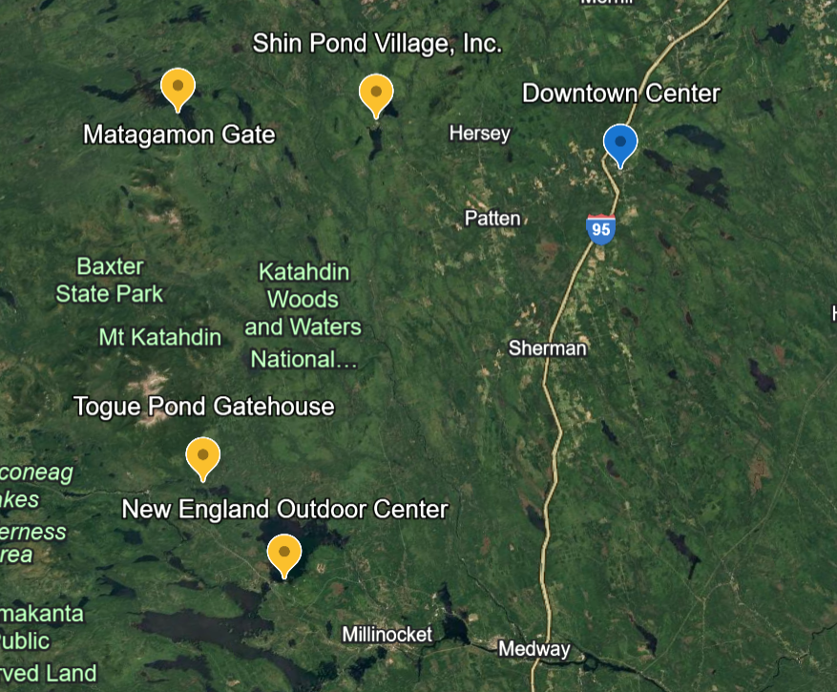
Nearby Models of Success
DOES OPPORTUNITY EXIST?
Look at town attributes
Location! Location! Location.!
Highway access. Two lakes. A major river system. Thousands of acres for everything Maine outdoors! Clean. Close to Sate Park. Close to Woods and Waters National Monument.

Slide 25
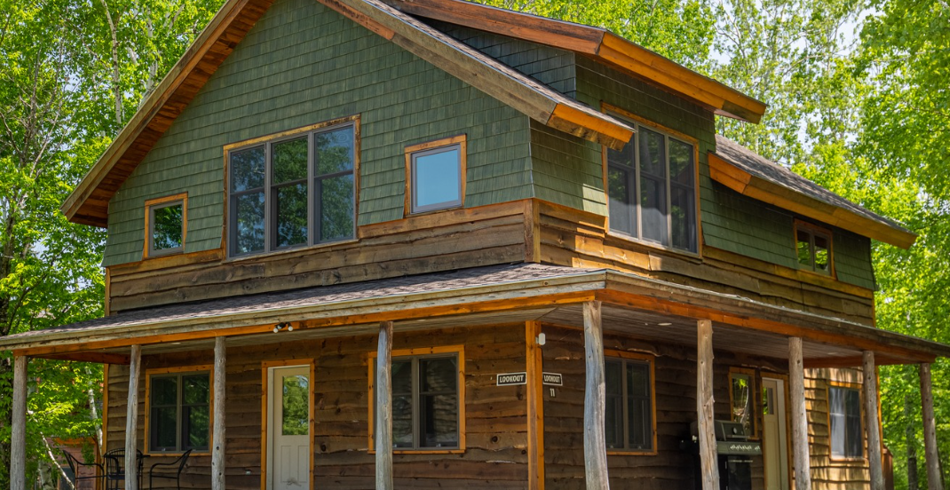
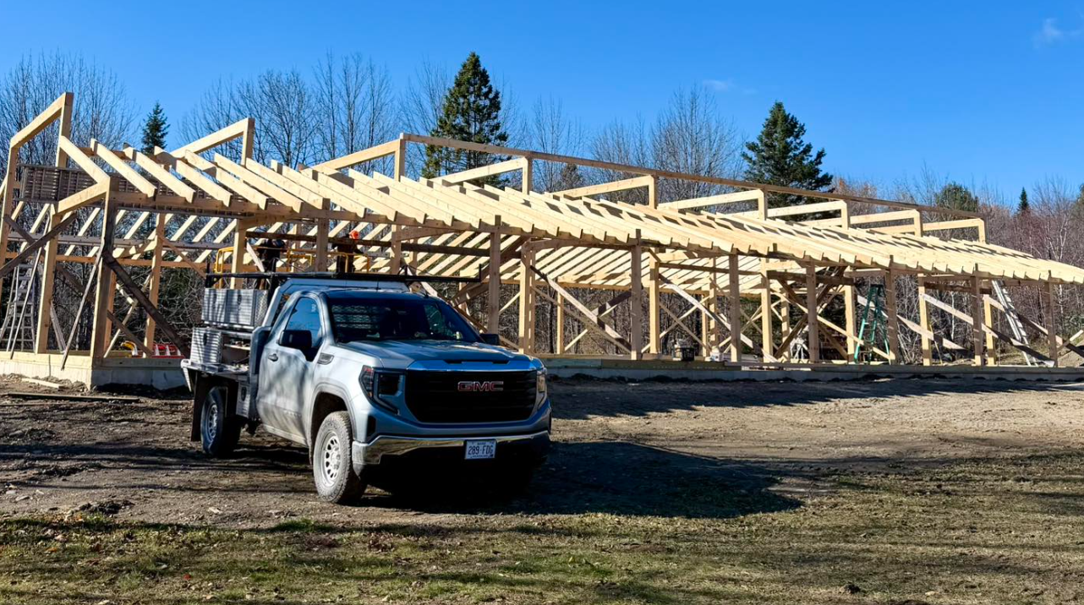
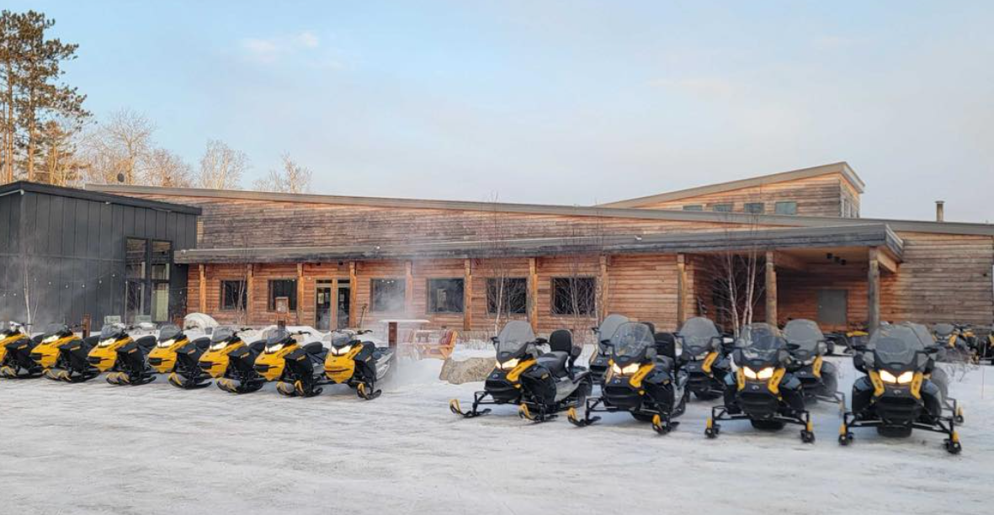
HOW SO?
Look at nearby models of success
New England Outdoor Center – Lodging & Event Center, Brewery & Restaurant
Year around demand for lodging has encouraged the recent developments that have translated into a Brewery/Restaurant & Event Space
Shin Pond – Lodging & Development of Event Center
Competitively speaking, Island Falls should be competition!

Slide 26
Can anything be done? Are we pass the point of no return?
  Let’s look at models
      During periods of economic decline, steps are taken to stimulate economic activity.
        Our central bank, the Federal Reserve, takes steps to increase the money supply.
        Government spending helps recharge the economic engine during economic recessions and has been the standard tool aiding in the road to from decline to growth.
    Economic conditions are always changing. Adapting is the key to Economic Growth!
  If you can’t find a model, BE A MODEL

Slide 27
So, why doesn’t some entrepreneur run a business in the old Starch Factory?
  This is highly unlikely! Well, as it sits today anyway… As economies change, entrepreneurs are motivated by the expected results from -
    Economic profit. The cost to purchase and clean up the current property is far greater than what it would cost to start new.
      Entrepreneurs (creditors/investors) avoid losses!

Slide 28
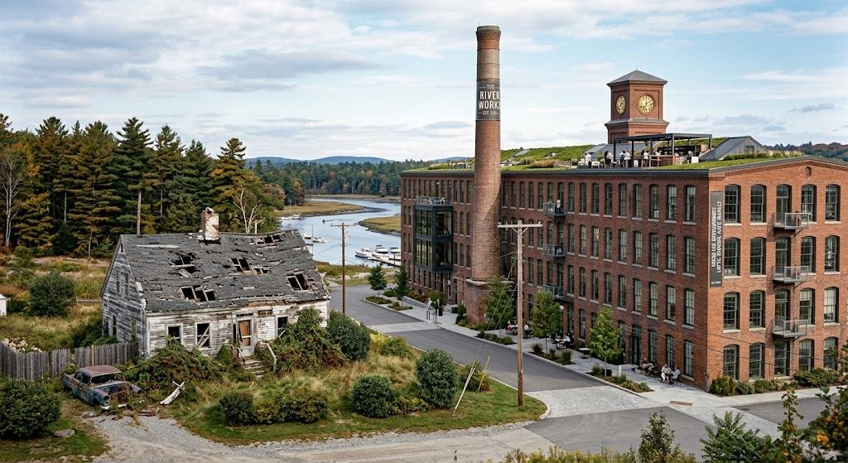
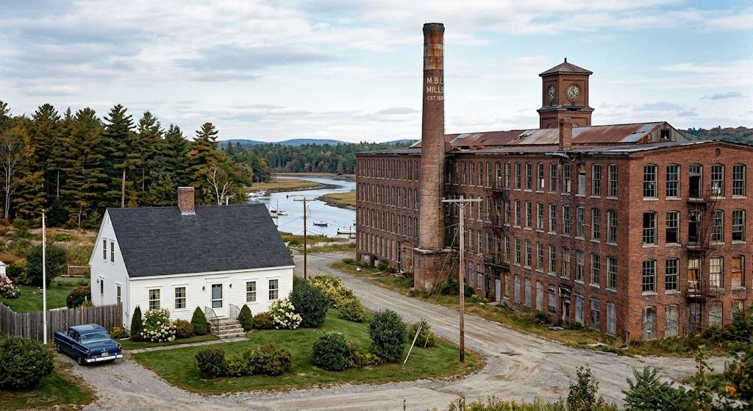
  Can we start small? See how it goes?
Public private partnerships working together can fix the BIG problems.
With the big problems fixed, the rest will happen naturally through private investment.
If left ignored, a suppression of growth will push encourage an environment lacking maintenance and private investment.

Slide 29
Take the first step in moving our town into the future and capitalize on the opportunity that we all agree exists.
The first step in resolving our anchor property problem is to create an economic development arm to facilitate negotiations regarding the purchase, clean up, and rebuild of our valuable downtown. With this step, obtain a $3,000,000 commitment
Step two – harness the benefits of a TIF, allowing us the greatest return of our investment that can help support growth for a period of up to 30 years.

Slide 30
